Slide 1
PINN for Solving Inverse Problems
CISC489/689
Connor Ludwin, Yaren Usul, Ella Wilkins

Slide 2
Motivation
Inverse problems are used to infer parameters based on given observations
Used widely in engineering and scientific disciplines
Difficult to solve because they can have multiple solutions and large sensitivity to noise
Optimization-based
Numerical solutions
New solution! Physics-Informed Neural Networks (PINNs) combined with Invertible Neural Networks (INNs) along with Bayesian Inference, for solving inverse problems.
Notes:
PINNs are a promising approach because they integrate physical laws (represented by PDEs) directly into the neural network through the loss function, ensuring that the solutions incorporate physics. PINNs lack in: noise handling and uncertainty quantification.
Key components:
Physics-Informed Learning: incorporate physical constraints into the neural network’s loss function, ensure that the predicted solutions obey the governing PDEs, which is crucial for maintaining physical accuracy.
Invertible Neural Networks: allows for a well-defined forward and inverse mapping, which is important in mapping data back to unknown parameters.
Uncertainty Quantification: Bayesian framework provides a natural way to estimate uncertainty in the model’s predictions, which helps address the inherent noise in real-world data.
Efficiency: Designed to handle large datasets and high-dimensional problems efficiently, making it suitable for complex inverse problems.

Slide 3
Background
Regularization
Penalizes undesired parameter features
Bayesian Inference
Incorporates uncertainties and prior information
Computationally expensive
Variational Methods
Challenges in high-dimensional settings
Notes:
To understand our approach, here’s some quick background:
First, we have Regularization.
This technique helps prevent overfitting by penalizing parameters that the model might be relying on too much.
It basically discourages the model from becoming too complex.
Next is Bayesian Inference.
This approach allows us to include uncertainty and prior knowledge into our models.
But the downside is—it’s often very slow and computationally expensive, especially in high dimensions.
Finally, there are Variational Methods.
These are used to approximate complex distributions, but they can struggle when the input space is really large or high-dimensional.

Slide 4
Background of paper
Efficient Bayesian Inference Using Physics-Informed Invertible Neural Networks For Inverse Problems by Guan et. al.
Sub-networks
Invertible neural network (INN)
Neural basis network (NB-Net)
Efficacy and precision quantified by
Numerical experiments (inverse kinematics, 1-dimensional and 2-dimensional diffusion equations, and seismic traveltime tomography)
Proposed loss compared to kernel-based maximum mean discrepancy loss
Notes:
This paper uses this approach along with sub-networks
They also proposed a new loss function and compared it to an existing one — called maximum mean discrepancy. Their loss function was:
Independence Loss (denoted as Lin)
This new loss encourages the model to keep the output yyy and the latent variable zzz statistically independent. It's easier to compute than MMD, works better in high dimensions, and leads to more accurate and reliable posterior samples.
Mathematical Form: It measures the squared difference between two KL divergences:
The paper we’re basing our project on combines two neural networks: an Invertible Neural Network and a Neural Basis Network (an architecture for machine learning that uses a single neural network to learn a set of shared basis functions. )
They tested it on different problems like inverse kinematics and diffusion.
In the paper by Guan et al., the authors validated their proposed Physics-Informed Invertible Neural Network (PI-INN) by applying it to four different inverse problems, all solved using numerical simulations (not real data). Here's what each experiment meant in the context of the paper:
Inverse Kinematics
A simplified robot arm model with 4 joint parameters. The goal: infer joint configurations that produce a given end-effector position.
The authors used this to test whether the INN can model multi-modal inverse solutions. (artificial intelligence that processes and integrates multiple types of data, like images, audio, and text, at the same time)
1D Diffusion Equation
A partial differential equation modeling how a quantity (like temperature) diffuses over space.
The task: infer the spatially varying diffusion coefficient from the observed state. This showed how the method handles continuous spatial fields.
2D Diffusion Equation
An extension of the 1D case into two spatial dimensions. Much more complex due to higher input dimensionality.
Used to test scalability and spatial smoothness in parameter recovery.
Seismic Traveltime Tomography
A geophysics problem: infer subsurface wave speeds from how long it takes seismic waves to reach different points.
The PI-INN must infer a 2D velocity field based on traveltime data.
This was used to evaluate the model on a real-world style application with noisy and limited data.
In short: These four tests were chosen to demonstrate that the PI-INN works well across different types of inverse problems, ranging from robotics to geophysics, and can handle both low-dimensional and high-dimensional cases while modeling uncertainty effectively.

Slide 5
Methods
Combined an INN with a basis function decoder (NB-Net)
Forward pass: Transformed parameters λ into [c, z], where:
c: Deterministic component (e.g., observable output)
z: Latent variable (to model uncertainty)
Inverse pass: Maps outputs and latent variables back to original input parameters (λ).
Training:
Supervised on synthetic inverse kinematics data
Loss = fit error + ABC loss + independence regularization
Optimized with Adam (1200 epochs, batch size 64)
Inference:
Sample latent z ~ N(0, I), invert with fixed y to generate posterior over λ
Compare with rejection-based ABC baseline
Evaluation:
Posterior quality visualized with corner plots (scatter, histograms, KDE)
Notes:
Here’s how the method works:
We combined an Invertible Neural Network with NB-Net, which lets us map between inputs and outputs in both directions.
For the forward pass:
We start with input parameters, which we call lambda, and the model transforms them into two parts:
One part is c, which is the actual predicted output.
The other part is z, which is a latent, or hidden, variable that helps the model account for uncertainty.
For the inverse pass:
We take the output and a sampled z value, and the model maps them back to the original inputs.
This is what allows us to solve inverse problems—basically figuring out what input would have caused a certain output.
For training, we used synthetic data
Our loss function had three parts:
First, a term that measures how accurate the output is,
Second, a term from Approximate Bayesian Computation, or ABC,
And third, a regularization term to keep c and z independent of each other.
We trained the model using the Adam optimizer, for 1200 epochs with a batch size of 64.
At inference time:
We fix the output we observed, and then sample z from a normal distribution.
We run those values backwards through the network to get a distribution over possible input values.
We also compared this to a simpler baseline method that uses rejection-based ABC.
Finally, for evaluation, we visualized the quality of our results using corner plots.
These include scatter plots, histograms, and density curves that help show how good and how uncertain our predictions are.

Slide 6
Algorithm 1 - INN
Learns a invertible mapping between parameters (λ) and outputs (y) + latent variables (z)
Forward pass: Maps λ → [y, z]
Inverse pass: Fix observed y, sample latent z ~ N(0, I), then invert to estimate posterior λ
Trained with combined losses:
Fit loss (MSE between predicted y and true y)
Independence loss (encourages disentanglement of y and z)
ABC-inspired loss for better posterior quality
Efficient posterior sampling without repeated simulations
Notes:
Our first algorithm is the INN.
It learns a two-way mapping between parameters and outputs.
In the forward direction, it maps parameters to outputs and latent variables.
In the reverse, it generates possible input values given an output by sampling from a normal distribution.
It’s efficient and doesn’t need repeated simulations — just one model.

Slide 7
Algorithm 2 - ABC
Approximate Bayesian Computation (ABC)
Classical rejection sampling approach for inverse problems
Steps:
Sample λ from prior distribution
Simulate output y from λ
Accept λ if simulated y is within tolerance ε of observed y
Provides a baseline for posterior sampling accuracy
Computationally expensive due to many simulations and rejections
No learned model; purely simulation-driven
Notes:
The second algorithm is ABC — a classical method.
It samples possible inputs, simulates the output, and checks if it matches what we want.
If it’s close enough, it keeps it.
This gives us a set of possible answers, but it’s very slow and needs lots of simulations.
We use this as a baseline to compare how good our INN method is.

Slide 8
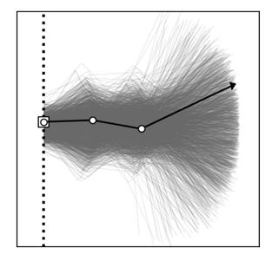

Results
Trying to replicate and improve upon the results of the inverse kinematics of the 3 link arm
Required using the loss hyperparameters to evaluate the impact of forward fitting loss, independent loss, and MMD/reverse MMD loss (Maximum Mean Discrepancy - compare two probability distributions based on their samples)
2 INN Models used with different loss variables:
Independence loss - helps make sure that the hidden variables don’t depend too much on the observed data
MMD loss - makes the hidden variables follow a normal distribution by comparing their patterns to what a normal distribution should look like.

Slide 9
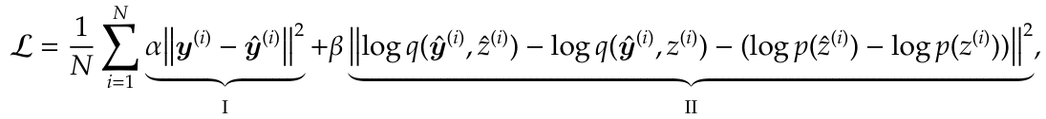
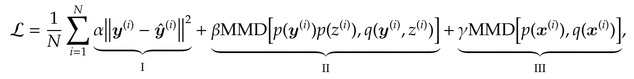
Equations
Independent Loss Equation:
MMD Loss Equation:

Slide 10
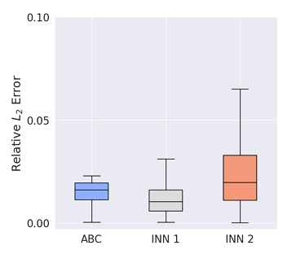

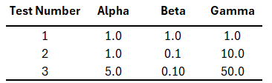
Paper Results
Measures how large the difference between the predicted and true values is, relative magnitude of the true values
Notes:
Predict the original parameters from observed data, then for each test sample, it generates many inverse candidates, selects the one that best reproduces the observed output, and then computes the relative L2 error between the predicted and true parameters.

Slide 11
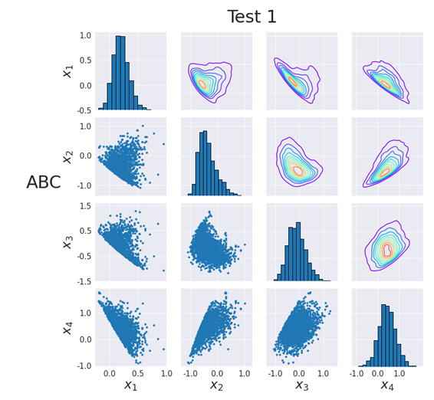
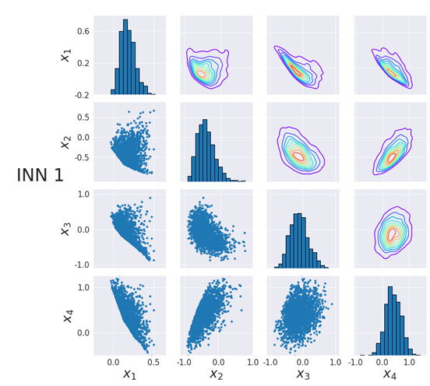
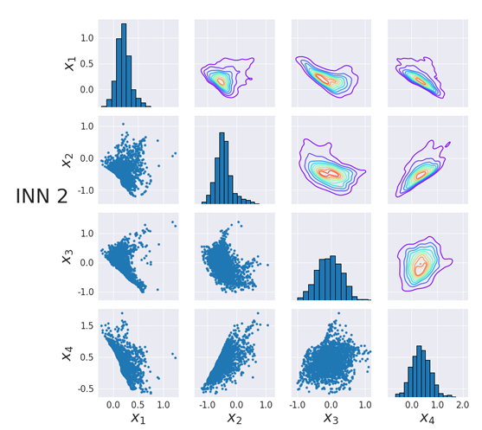
Paper Results
Sample Distributions

Slide 12
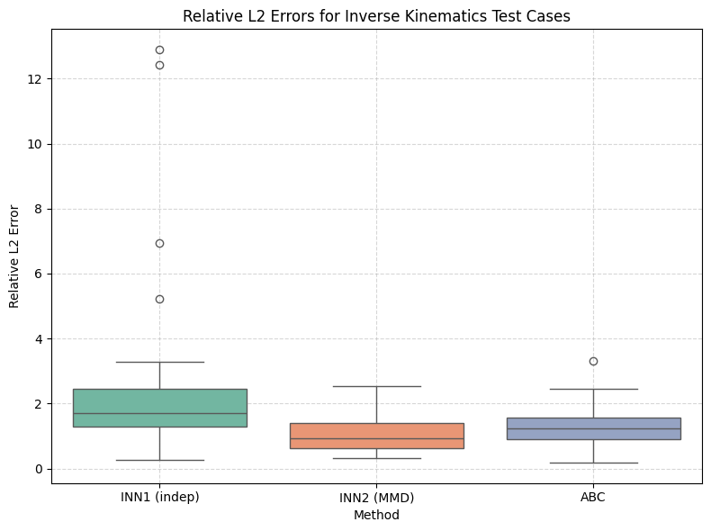
Our Results
Relative Error: Test 1

Slide 13
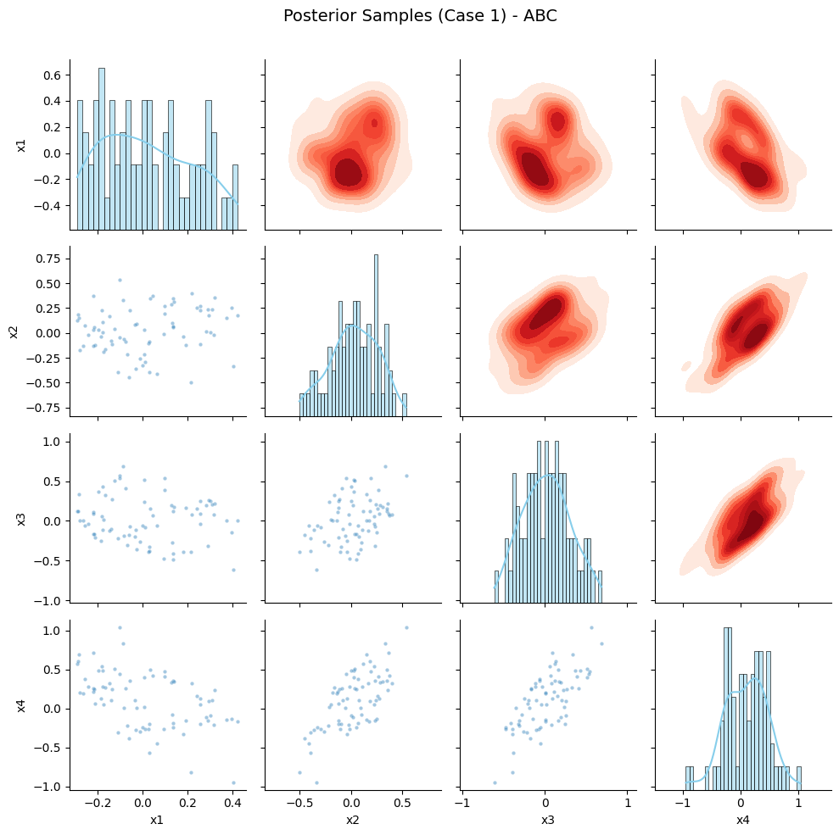
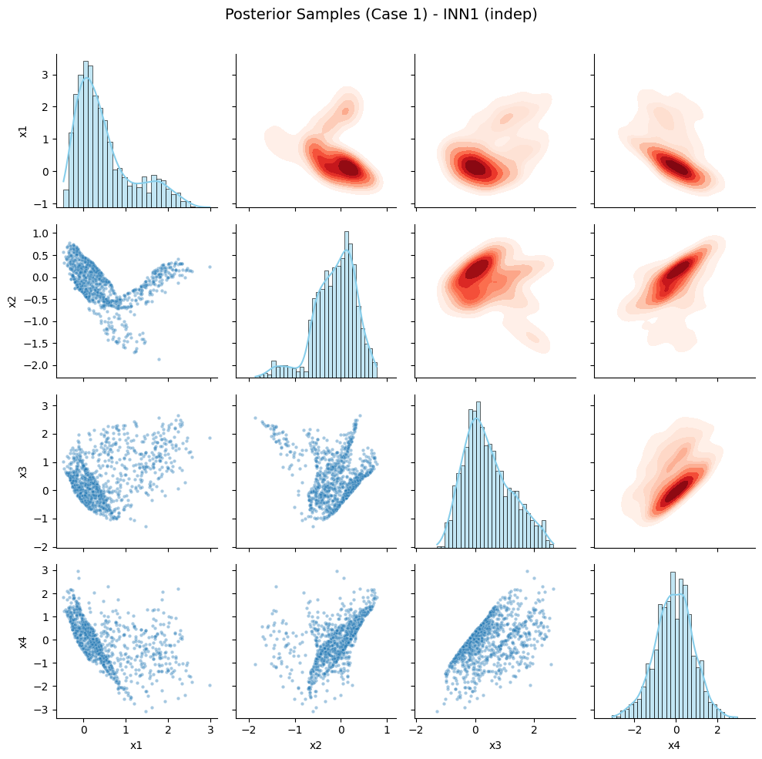
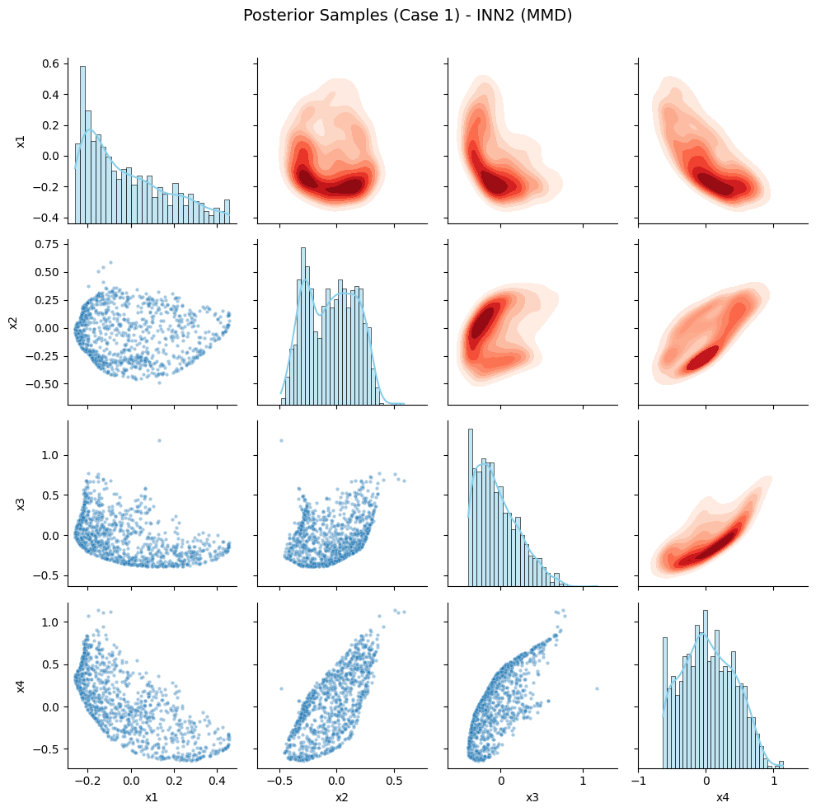
Our Results
Test 1 Sample distributions:

Slide 14
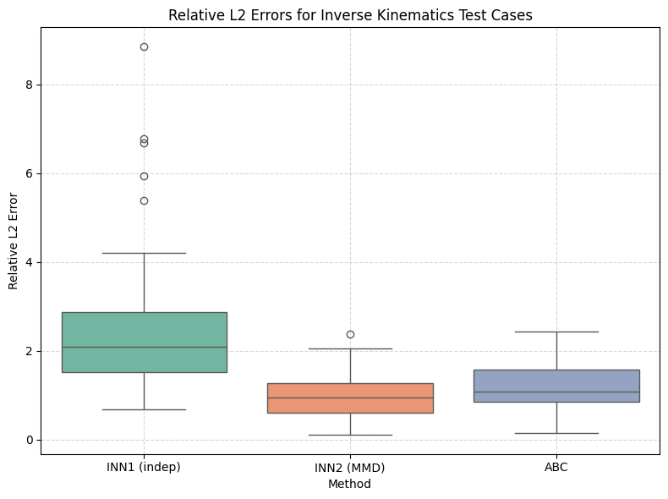
Our Results
Relative Error: Test 2

Slide 15
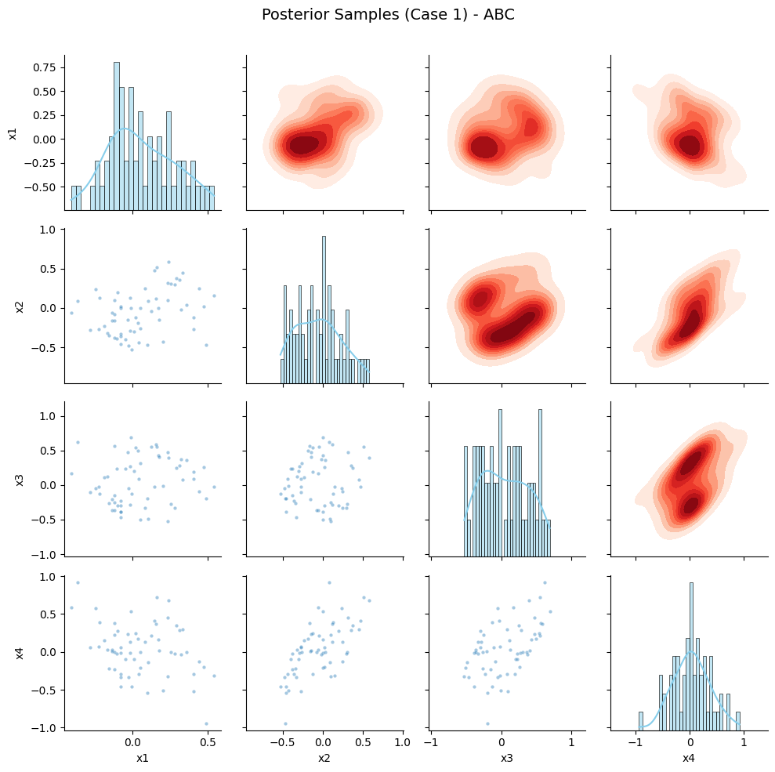
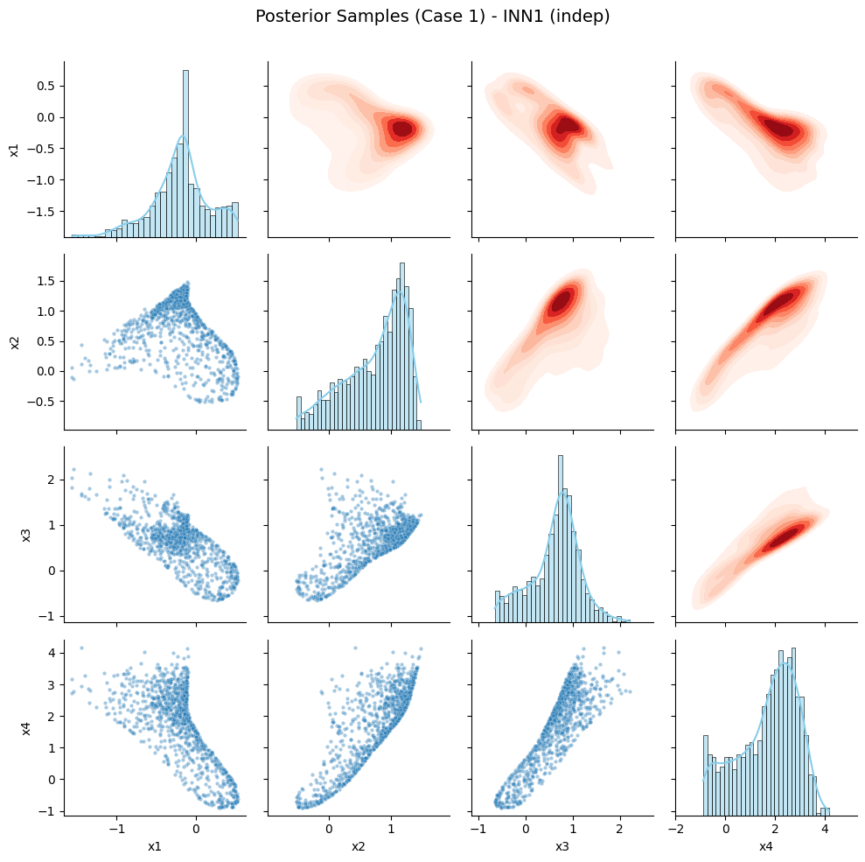
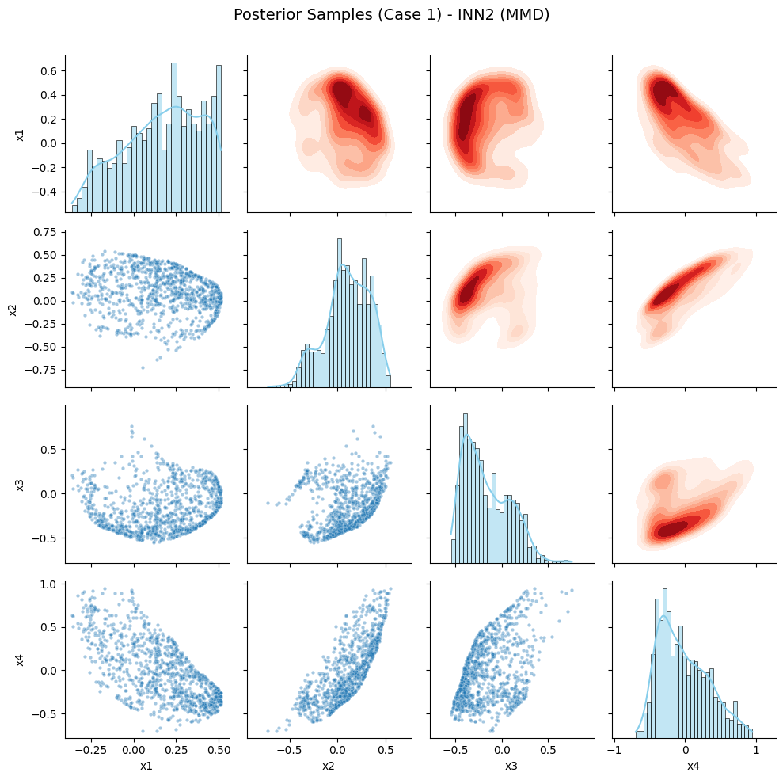
Our Results
Test 2 Sample distributions:

Slide 16
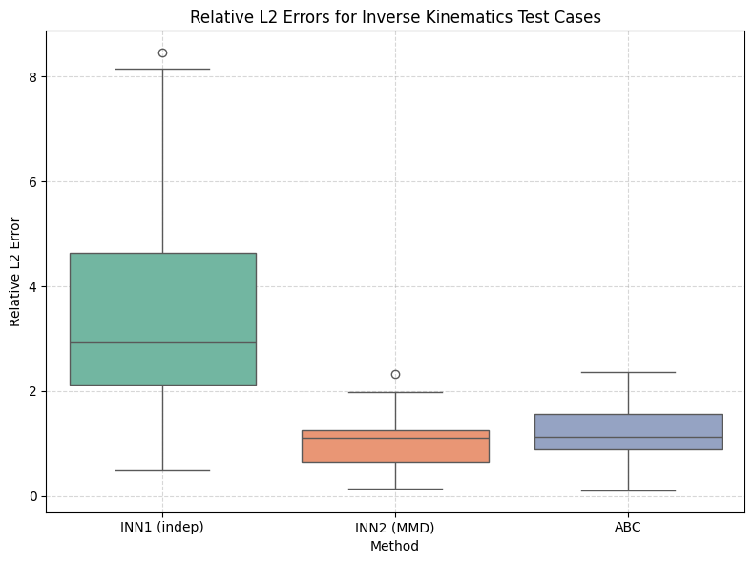
Our Results
Relative Error: Test 3

Slide 17
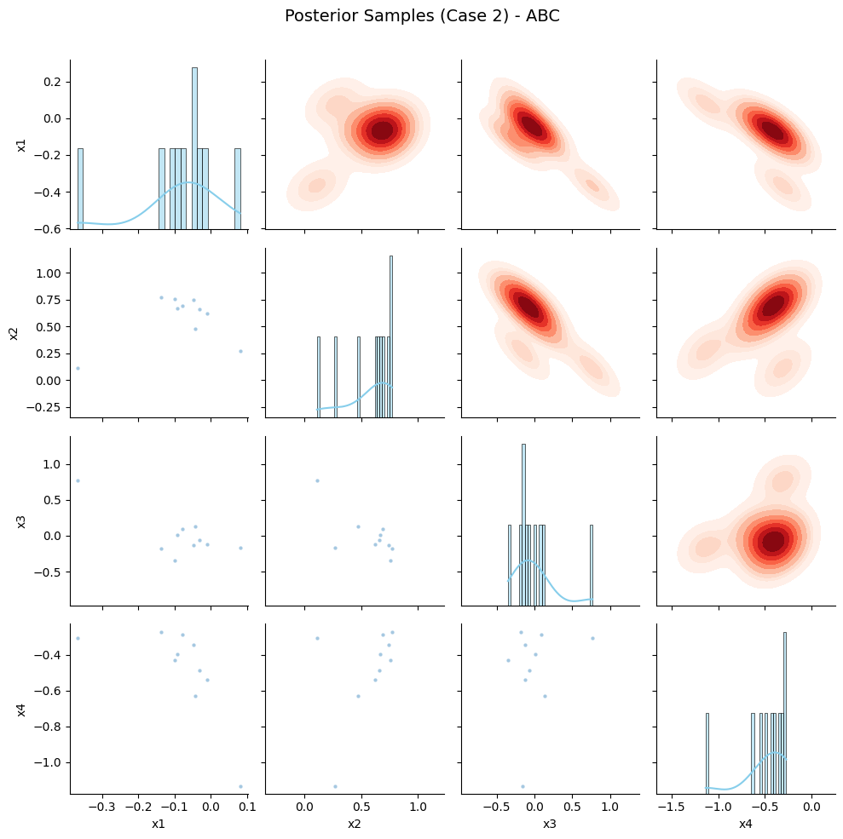
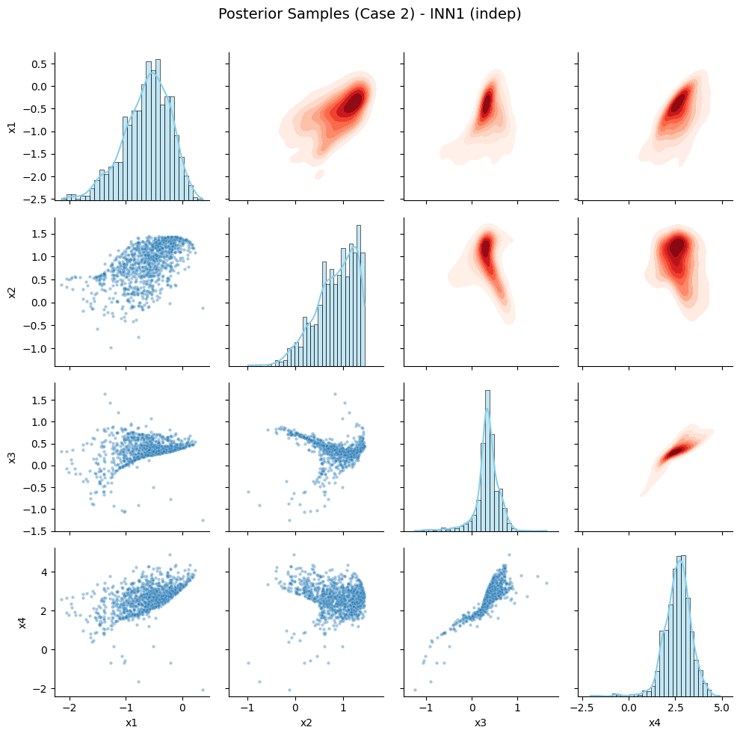
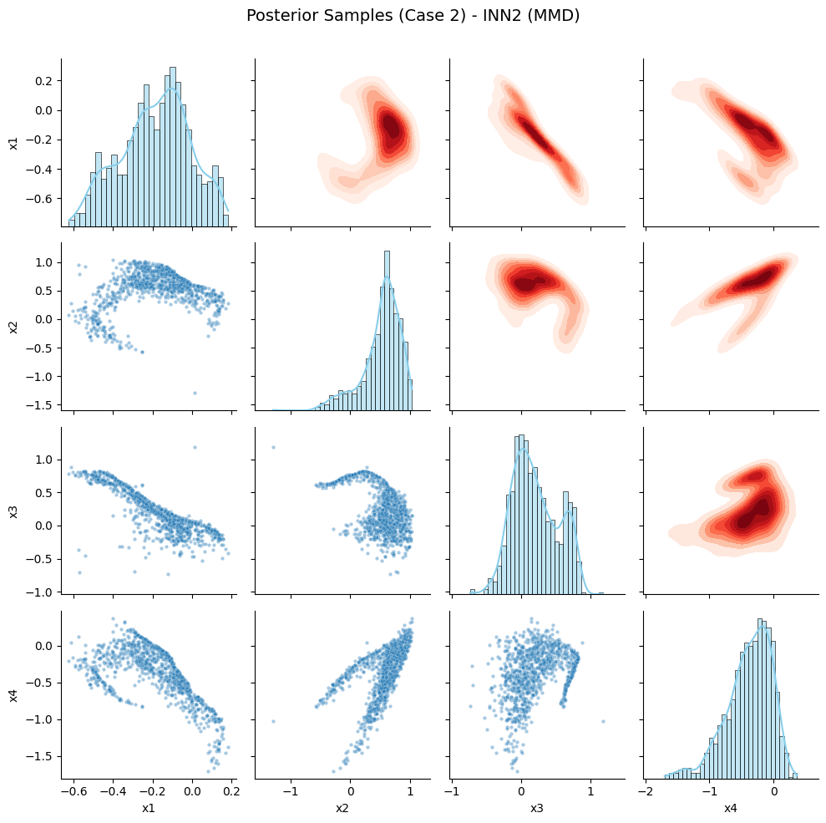
Our Results
Test 3 Sample distributions:

Slide 18
Challenges / Future Work
Scalability: Can this method work well on problems with more inputs (added noise)?
Loss Balancing: How can weights for fit and ABC losses be optimized more systematically? What other optimizers could we have used?
Model Design Choices: Would a different invertible model work better?
Notes:
A few challenges we noticed:
We’re not sure how well this method scales with more complex inputs or noisy data.
Also, how do we choose the best weights for the different parts of the loss?
And could we try other optimizers or invertible models?
Other optimizers:
SGD with Momentum Simpler but effective for stable convergence
AdamW Improved regularization vs Adam
RMSprop Often used in RNNs, good for noisy gradients
Adagrad / Adadelta Adaptive learning rates for sparse data
Other invertible models:
RealNVP Similar to current model, but often used with image data
Glow Invertible model with better latent space structure
NICE (Non-linear Independent Components Estimation) Simpler coupling layers, no scaling
i-ResNet (Invertible ResNet) Uses residual blocks in a reversible way

Slide 19
Conclusions
Implemented an Invertible Neural Network (INN) to learn the mapping between joint parameters and end-effector positions.
Model learns how to go both forward and backward between inputs and outputs.
INN is fast and flexible
This method can be used to help solving more complex problems in the future!
Notes:
To wrap up:
We implemented an Invertible Neural Network, or INN, to learn the mapping between joint parameters and end-effector positions
What’s really useful about the INN is that it doesn’t just go in one direction.
The model learns how to go both forward and backward—so we can predict the outcome from the input, and we can also go the other way and figure out what input would give us a certain result.
We also found that the INN is fast and flexible.
It trains well, and it generalizes to new situations without needing a ton of tuning.
So overall, this method shows a lot of potential.
It could definitely be applied to even more complex problems in the future.

Slide 20
Thank you!
Questions?

